Slide 1
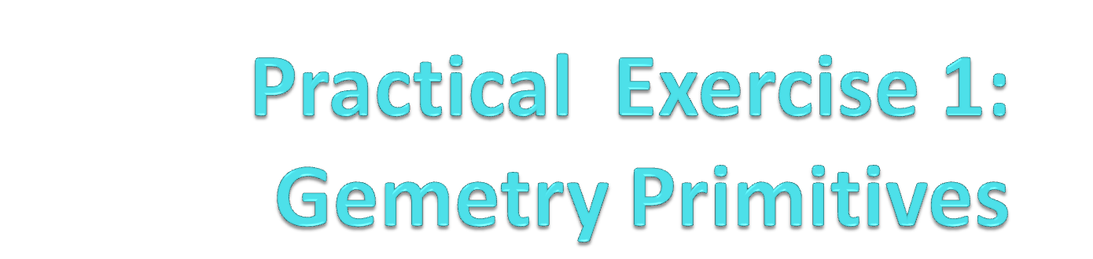
BACS 2173 Graphic Programming
[TOTAL : 12 marks]

Slide 2

Exercise Q1
Pahang Flag
(1 mark)

Slide 3

Exercise Q2
Negeri Sembilan Flag
(1 mark)

Slide 4

Exercise Q3
England Flag
(2 marks)

Slide 5

Exercise Q4
Scotland Flag
(2 marks)

Slide 6

Demo
Japan Flag

Slide 7
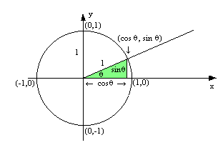
Demo
How to draw circle?

Slide 8

Exercise Q6 (Challenging)
Have a nice day~

Slide 9
Exercise Q6
Create a smiley face/ emoji/ character by using variety of geometry primitives (6 marks)
Criteria | Marks
Creativity | 2
Complexity of graphic | 3
Extra features | 1
TOTAL | 6

Slide 10

Samples Student Work

Slide 11

Sample Student Work

